Slide 1
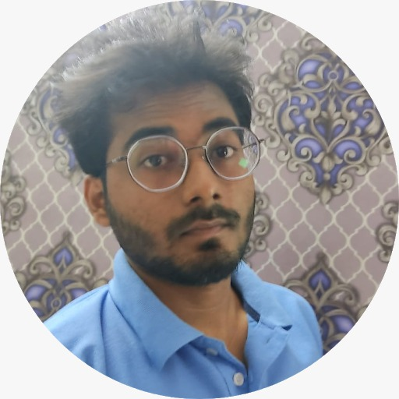
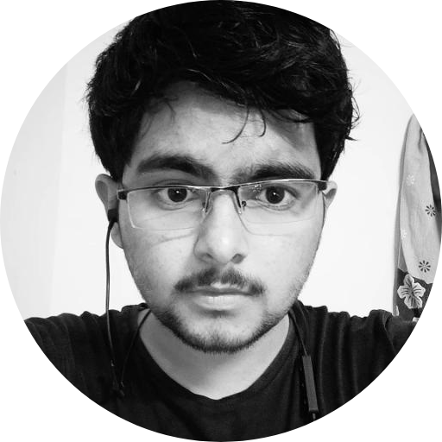
Team name : Alone
Theme: Wearable tech
FAIZAN ALAM
P.Karimulla Khan
First year student at Kalinga Institute of Industrial Technology.
First year student at Vellore Institute of Technology.

Slide 2
Problem statement
This project aims to solve the daily challenges faced by the people, who are unable to speak (dumb) or the ones who have recently undergone an accident and are temporarily unable to speak. It can also be used by elderly people, who find difficulty in speaking.
With this wearable hand assistant glove, dumb people or patients can easily communicate by just tapping the points on the glove by their thumb that results in 12 different commands that are both audible audio and image on any Android smartphone via. an application. This can also be used in automation of day to day gadgets like home appliances and many more.

Slide 3
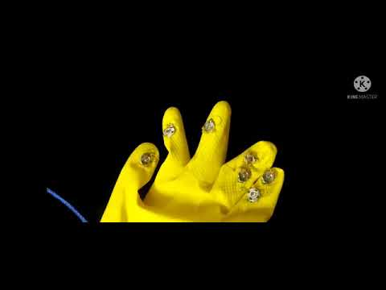
Video DEMONSTRATION

Slide 4
LIVE DEMONSTRATION

Slide 5
HARDWARE / SOFTWARE IMPLEMENTATION

Slide 6
This project consists of an Arduino UNO for processing. And HC-05 bluetooth module to send the data in an Android application.
Tapping the points on the glove by their thumb to send the command to the phone.
Flow Diagram : https://faizan-alam-1.github.io/Flow/

Slide 7
TECHNOLOGY STACK
● Microprocessor - Arduino UNO
● Bluetooth Module - HC-05
● Programming Language - C
● IDE - Arduino IDE
● App

Slide 8
NOVELTY

Slide 9
The project is unique in its function as till date dumb people have been using either sign language or used to simply point at things and the other person had to guess what exactly the person wants to convey ,but using our project he can simply press buttons and convey his exact feelings with ease and the other person need not also know the sign language .
Such a product has not been in use or development and hence itself makes this project unique.
.

Slide 10
BUSINESS SCOPE

Slide 11
It will be able to solve the issues of those people, who cannot learn or are unable to use ‘sign languages’ to communicate with others by providing them a ‘virtual voice’ and images. It will be both affordable and feasible.
It is easy to wear and customizable according to one’s needs. It can be used by people of any age group and also illiterate.

Slide 12
THANK YOU
HACKX

